Slide 1

Final Project (DATA 2204)
Submitted by
Vrushali Gajjar
100891561

Slide 2
Problem Statement
Here we have dataset of water portability. Where it has 10 variables about its pority level and water level.
We will try some models and curves for MR. Jhon.
We will take logistic regression and Naïve Bayes model for the comparison. Where we will see ROC curve for both the models to see better results.
Also, we will try Ensemble voting method for both of this model.
In the end, I will give some recommendation and implementation steps for Mr. Jhon that will help them to select better model.

Slide 3
Pandas Profile Report
With the help of Pandas Profile Report we can see the statistics of the dataset. Where we can see that the dataset has 10 variables.
Here we can also see that there are 0 missing values and 0% missing cells.
The Profile Report also shows number of observations which is 2007 for this dataset..

Slide 4
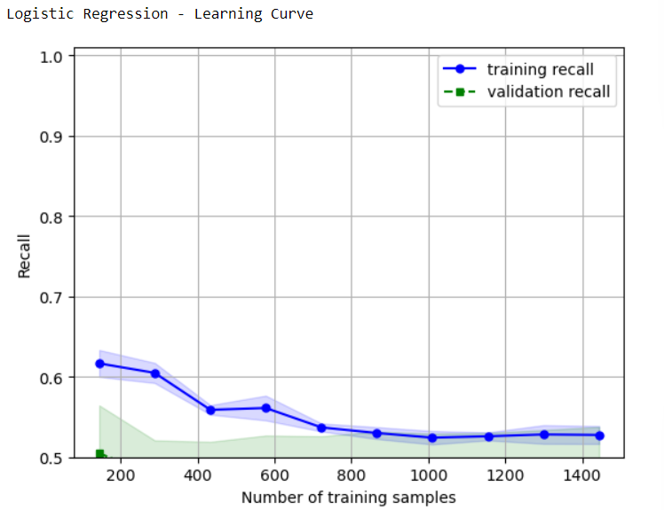
Logistic Regression Learning Curve
The training recall curve begins at roughly 0.62 and then declines further to 0.52, while the validation recall curve starts at 0.50 and follows an identical structure across every sample.
The training recall and validation recall trends of the logistic regression are essentially identical following the data reaches 700 samples.

Slide 5
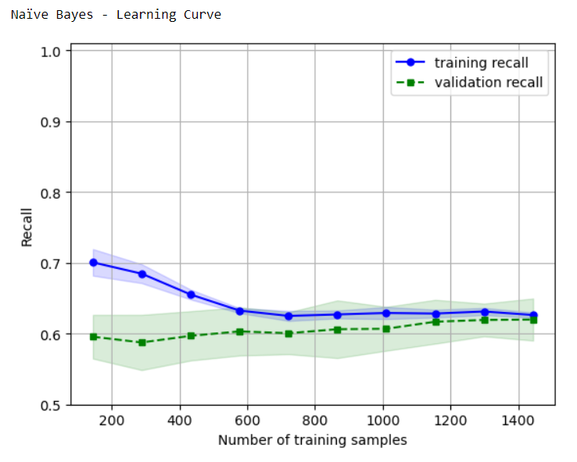
Naïve Bayes Learning Curve
The validation recall curve begins at 0.60 and follows a comparable pattern as the training recall curve in the set used for training, which starts at 0.7 and falls to 0.6.
A reduce curve is indicated by an identical distinction among the training and validation curves, which is known as the variance. so that the lesser distance reduces the variance in this model.

Slide 6
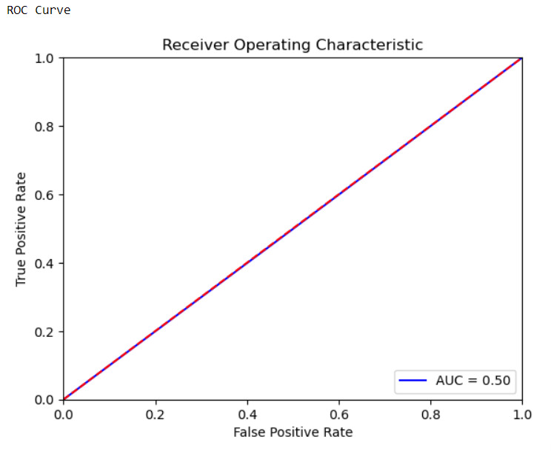
Logistic Regression (ROC Curve)
Logistic Regression ROC curve has 0.51 accuracy.
This curves recall is 0.26 to 0.54.
F1 score of this curve is 0.57 and precision is 0.60.
Here we can say that this model is not that much accurate for the better outcomes. However it is moderate in terms of their accuracy.

Slide 7
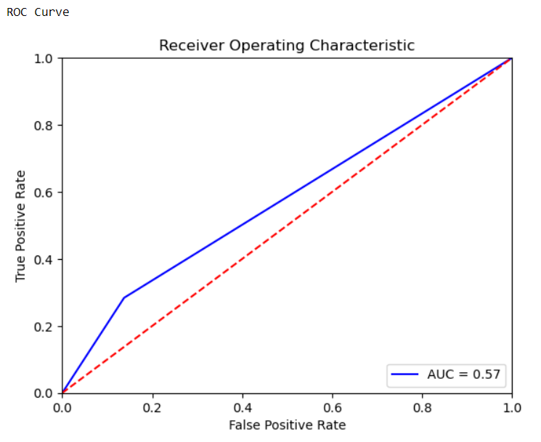
Naïve Bayes (ROC Curve)
Naïve Bayes curve’s precision is o.64 which is better than logistical ROC curve.
The recall is o.86 and the accuracy is o.63.
Also the f1 score of this curve is 0.74 for class 0 which is again a good Metrix for the model.
Here this curve is moderate. However, this curve is better than logistical curve.

Slide 8
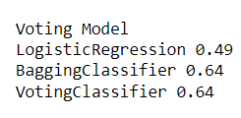
Ensemble Voting Model
With an accuracy rating of 0.49, the logistic regression model successfully predicted 49% of the test set cases. Contrarily, the accuracy score of the Bagging Classifier, which is 0.64, is significantly higher than that of the Logistic Regression model. This suggests that the Bagging Classifier outperforms the Logistic Regression model at outcome prediction.
The Logistic Regression model and the Bagging Classifier predictions are combined in the Voting Classifier, which also has an accuracy rating of 0.64. This is to be expected because the Voting Classifier may produce a prediction that is more accurate than either model alone because it considers the predictions from the two models when making its final judgement.
Overall, Ensemble voting of bagging classifier is a good model than logistic regression. However, Naïve Bayes and bagging classifier is almost similar to each other.

Slide 9
Implementation
Here I would prefer MR. Jhon that they should implement Ensemble Voting model as it it more accurate than Logistic regression or Naïve bayes.
Additionally, it can lower the chance of overfitting and increase the predictability. An ensemble voting model can also handle datasets and problems that may be difficult for individual models to handle. An ensemble voting model can, in general, offer a more stable and dependable answer to machine learning issues.

Slide 10
Recommendation
Execute feature selection as one method of enhancing the combined voting model's accessibility. In order to enhance the performance of the model, this entails locating and choosing the dataset's most pertinent features. A model can be made simpler, easier to understand, and more effective by reducing the number of features. This can improve the model's accessibility, particularly in cases where the dataset has numerous features or where some of the features are unimportant or noisy.
Hyperparameter tuning is a different method for enhancing the ensemble voting model's usability. To maximize the performance of each model in the ensemble, this entails choosing the most effective set of hyperparameters. The models can be more accurately calibrated to the problem and dataset by adjusting the hyperparameters, which can also enhance the efficacy of the models' generalization capabilities. By boosting the model's functionality while rendering it more durable and trustworthy, this may make it more useful.

